Slide 1
FOREGROUND EXTRACTION
Foreground extraction is used to extract any image or object that is of interest to us, and discard the rest of the background.
Recent deep learning based image segmentation techniques have made this really easier.
But we can achieve this using pure computer vision techniques as well.
Popular Foreground extraction methods:
Grabcut Algorithm
Contour Detection

Slide 2
Grabcut algorithm
The region of interest is decided by the amount of segmentation of foreground and background to be performed and is chosen by the user.
Everything outside the ROI is considered as background and turned black. The elements inside the ROI is still unknown.
Then Gaussian Mixture Model(GMM) is used for modeling the foreground and the background.
Then, in accordance with the data provided by the user, the GMM learns and creates labels for the unknown pixels and each pixel is clustered in terms of color statistics.
A graph is generated from this pixel distribution where the pixels are considered as nodes and two additional nodes are added that is the Source node and Sink node.
All the foreground pixels are connected to the Source node and every Background pixel is connected to the Sink node.
The weights of edges connecting pixels to the Source node and to the End node are defined by the probability of a pixel being in the foreground or in the background.

Slide 3
Grabcut algorithm
If huge dissimilarity is found in pixel color, the low weight is assigned to that edge. Then the algorithm is applied to segment the graph.
The algorithm segments the graph into two, separating the source node and the sink node with the help of a cost function which is the sum of all weights of the edges that are segmented.
After the segmentation, the pixels that are connected to the Source node is labeled as foreground and those pixels which are connected to the Sink node is labeled as background.
This process is done for multiple iterations as specified by the user. This gives us the extracted foreground.
Function used: cv2.grabCut()
But in some cases, the segmentation won't be fine, like, it may have marked some foreground region as background and vice versa. In that case, user need to do fine tuning.

Slide 4
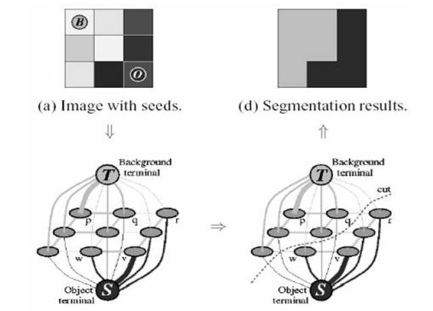
Grabcut algorithm

Slide 5
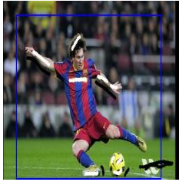
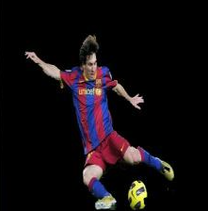


GRABCUT ALGORITHM RESULTS (SAMPLE)
Input: Output:
Transitions

Slide 6
CONTOUR DETECTION
In simple terms, we need to find the area or pixels bounding the object of interest.
After that we can treat it as a foreground image and discard the rest of the things as background image.
Using contour detection, we can find the pixels surrounding the object that we want to extract and then proceed further.
find_largest_contour() is used to accomplish this.

Slide 7
BACKground SUbtraction
Background subtraction is a method of eliminating the background from image. To achieve this we extract the moving foreground from the static background.
Background Subtraction has several use cases such as object segmentation, security enhancement, pedestrian tracking, counting the number of visitors, number of vehicles in traffic etc. It is able to learn and identify the foreground mask.
Background subtraction algorithms in OpenCV:
BackgroundSubtractorMOG – It is a Gaussian Mixture-based Background/Foreground Segmentation Algorithm.
BackgroundSubtractorMOG2 – It is also a Gaussian Mixture-based Background/Foreground Segmentation Algorithm. It provides better adaptability to varying scenes due illumination changes etc.
BackgroundSubtractorGMG – This algorithm combines statistical background image estimation and per-pixel Bayesian segmentation.

Slide 8
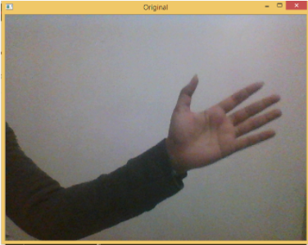
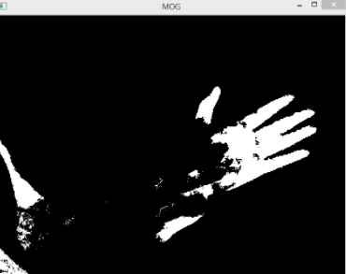
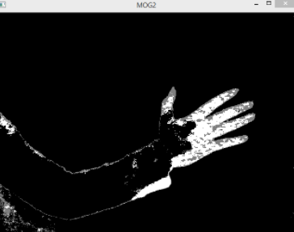
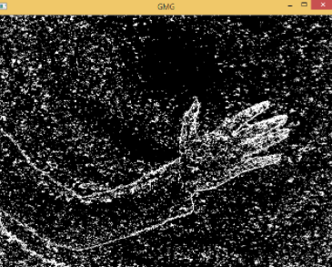
BACKGROUND SUBTRACTION
Input:
Output:

